Slide 1
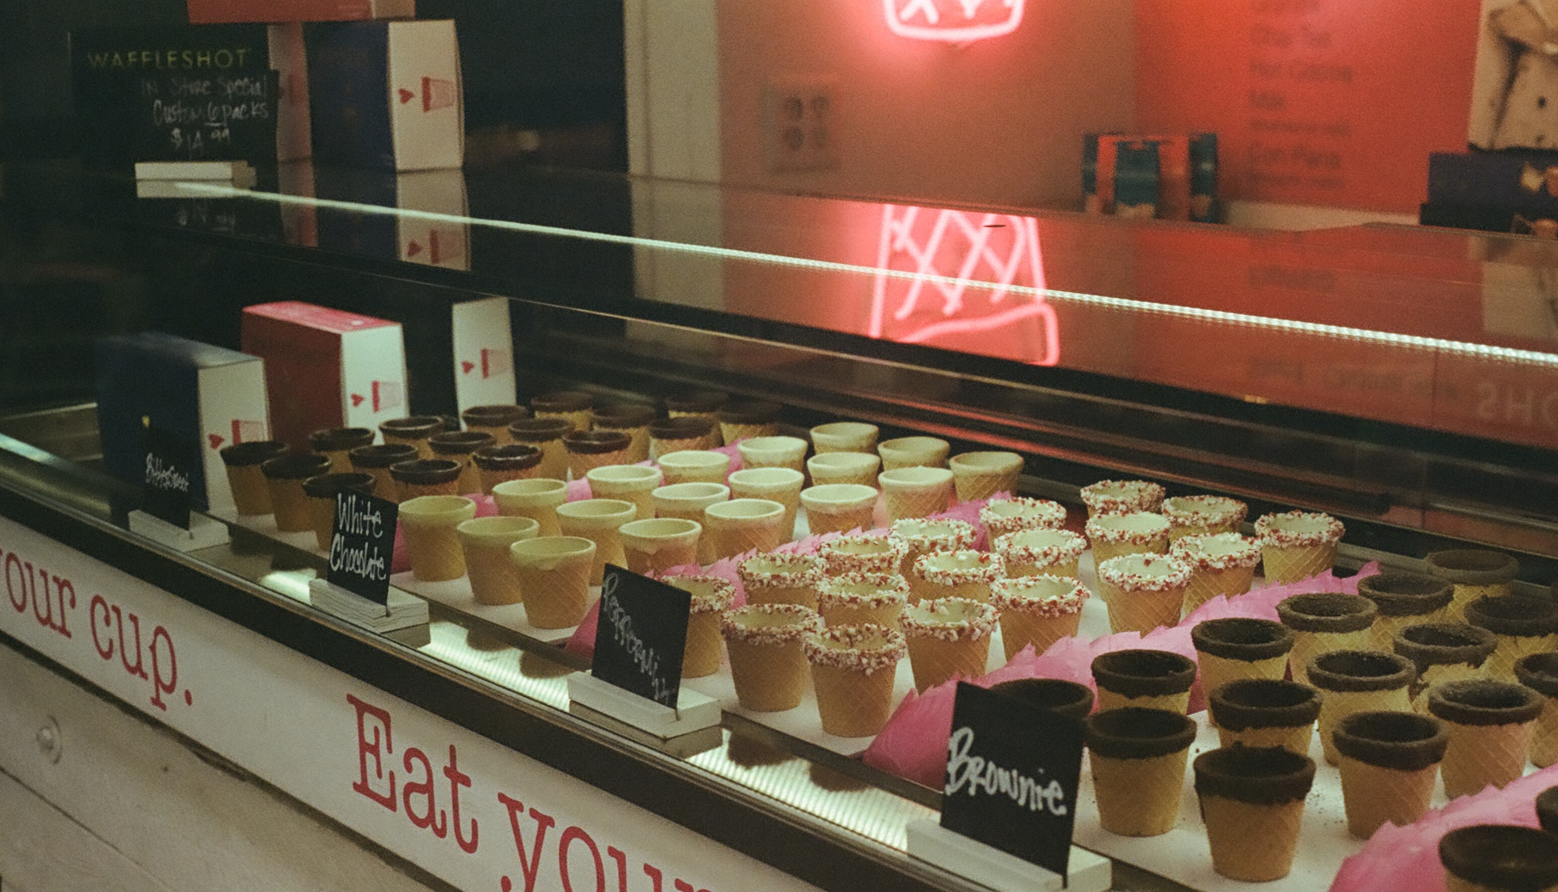
Notes:
Client’s doesn’t aways know what they want

Slide 2

Notes:
Explain what scope creep is and how it occurs.
Imagine that you are planning a very simple Bday party… You go for a nice cake

Slide 3

Notes:
Some nice balloons… but out of nowhere, things starts getting out of control

Slide 4
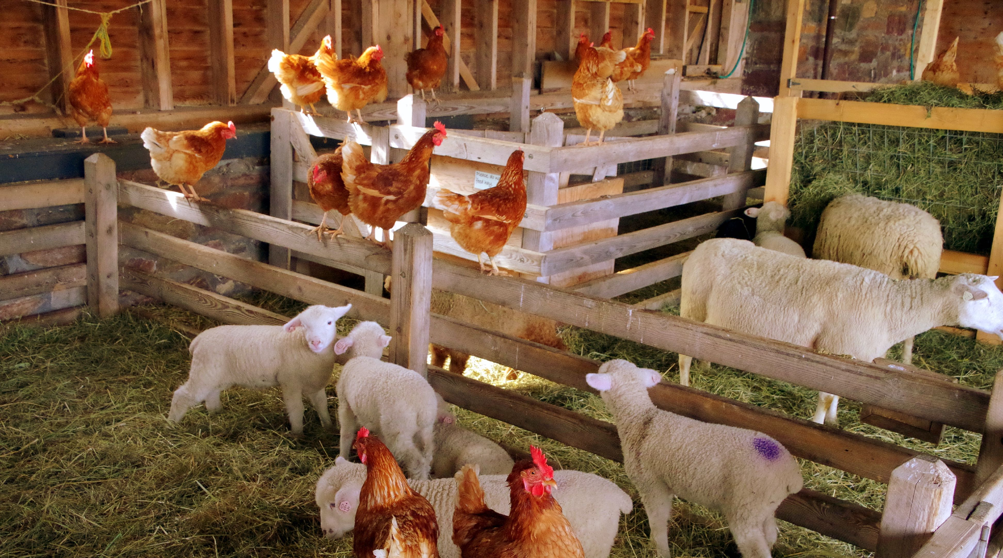
Notes:
And you get a Pet Zoo…

Slide 5
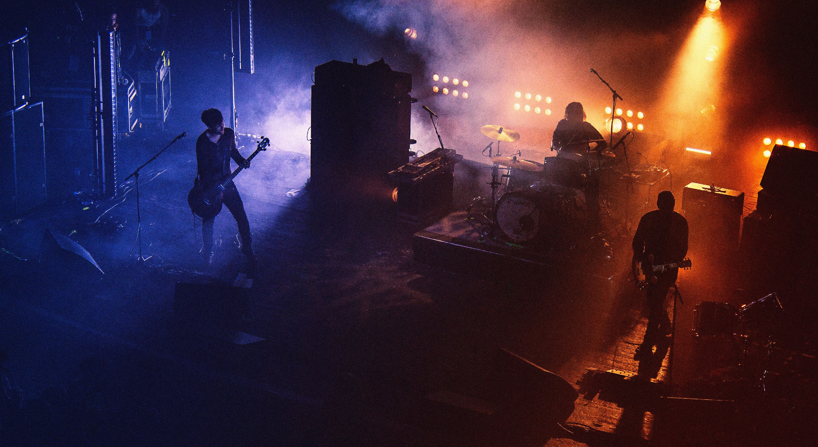
Notes:
A live band …

Slide 6

Notes:
And a very expensive show of Fireworks

